Slide 1
Basic Approaches to Leadership
© 2007 Prentice Hall Inc. All rights reserved.

Slide 2

What Is Leadership?
Leadership
The ability to influence a group toward the achievement of goals.
Management
Use of authority inherent in designated formal rank to obtain compliance from organizational members.
© 2007 Prentice Hall Inc. All rights reserved.

Slide 3

Trait Theories
Traits Theories of Leadership
Theories that consider personality, social, physical, or intellectual traits to differentiate leaders from nonleaders.
Leadership Traits:
Extraversion
Conscientiousness
Openness
Emotional Intelligence (qualified)
© 2007 Prentice Hall Inc. All rights reserved.

Slide 4
Innate Qualities acc to Trait Theories
Physical features
Intelligence
Emotional Stability
Human relations
Empathy
Objectivity
Motivating skills
Technical skills
Communication skills
Social skills
© 2007 Prentice Hall Inc. All rights reserved.

Slide 5
Trait Theories
Limitations:
No universal traits found that predict leadership in all situations.
Unclear evidence of the cause and effect of relationship of leadership and traits.
Better predictor of the appearance of leadership than distinguishing effective and ineffective leaders.
© 2007 Prentice Hall Inc. All rights reserved.

Slide 6
Trait Approach
Traits (examples)
  Extraversion
  Conscientiousness
  Openness
Assumption: Leaders are born
Goal: Select leaders
Problems
  Traits do not generalize across situations
  Better at predicting leader emergence than leader effectiveness

Slide 7
Leadership Styles
Based on Behavioral Approach
  Power Orientation
  Leadership as a continuum
  Employee- Production Orientation
  Likert’s management system
  Managerial Grid
  Tri-dimensional Grid
Based on Situational Approach
  Fiedler’s Contingency Model
  Cognitive Resource Theory
  Hersey and Blanchard’s Situational Leadership Model
  Path Goal Theory

Slide 8
Power Orientation
Autocratic Leadership
  Strict Autocrat
  Benevolent Autocrat
  Incompetent Autocrat
Participative Leadership
  Also known as democratic/consultative/ideographic leadership
  Decentralizes his decision-making
Free-rein Leadership
  Managers decides policy, programs and limitations for actions and the entire process is left on subordinates
© 2007 Prentice Hall Inc. All rights reserved.

Slide 9
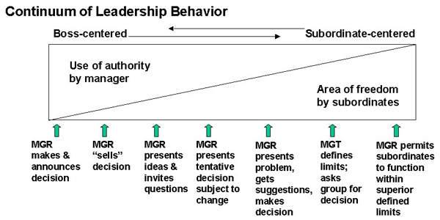
Leadership as a continuum
© 2007 Prentice Hall Inc. All rights reserved.

Slide 10
Depends on
Forces in manager
  Value system, confidence in his subordinates, his own leadership inclination, his feeling of security(trust)
Forces in subordinates
  Need for independence, readiness to assume responsibility, level of tolerance for ambiguity, interest, understanding, knowledge, experience
Forces in situation
  Type of org., group effectiveness, problem itself and pressure of time.
© 2007 Prentice Hall Inc. All rights reserved.

Slide 11
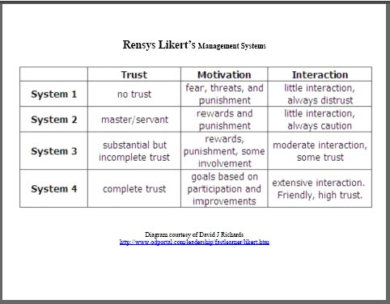
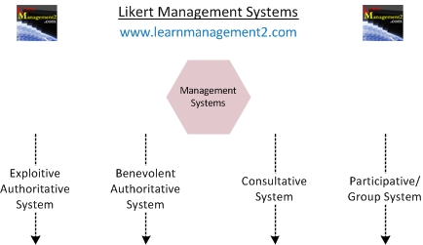
Rensis Likert’s Management System
© 2007 Prentice Hall Inc. All rights reserved.

Slide 12
Ohio State Studies
Initiating Structure
The extent to which a leader is likely to define and structure his or her role and those of sub-ordinates in the search for goal attainment.
Consideration
The extent to which a leader is likely to have job relationships characterized by mutual trust, respect for subordinate’s ideas, and regard for their feelings.
© 2007 Prentice Hall Inc. All rights reserved.

Slide 13
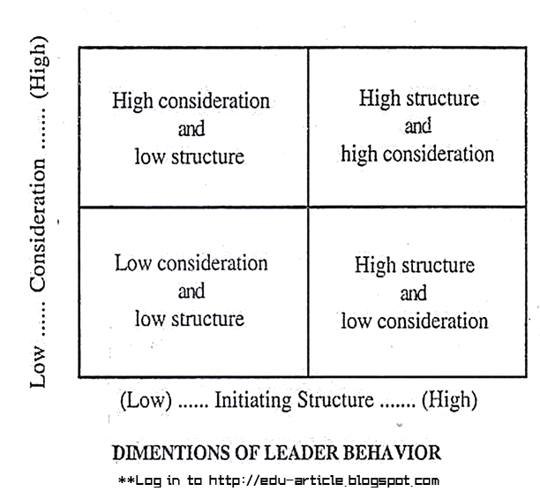
© 2007 Prentice Hall Inc. All rights reserved.

Slide 14
University of Michigan Studies
Employee-Oriented Leader
Emphasizing interpersonal relations; taking a personal interest in the needs of employees and accepting individual differences among members.
Production-Oriented Leader
One who emphasizes technical or task aspects of the job.
© 2007 Prentice Hall Inc. All rights reserved.

Slide 15
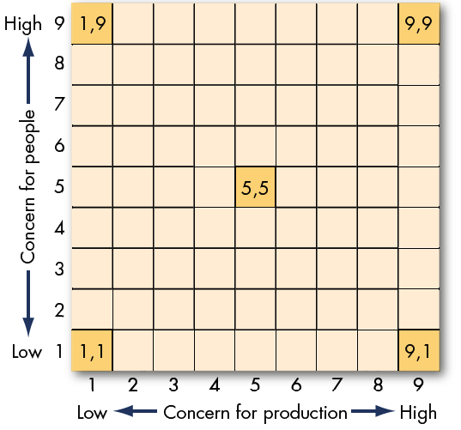
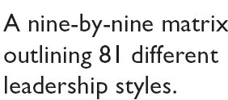
The Managerial Grid
(Blake and Mouton)
E X H I B I T 12–1
© 2007 Prentice Hall Inc. All rights reserved.

Slide 16
Managerial Grid (Blake & Mouton)
Impoverished Management (1,1)– Low Results/Low People
  This leader is mostly ineffective. He/she has neither a high regard for creating systems for getting the job done, nor for creating a work environment that is satisfying and motivating. The result is disorganization, dissatisfaction and disharmony.
Country Club Management (1,9) – High People/Low Results
  This style of leader is most concerned about the needs and feelings of members of his/her team. These people operate under the assumption that as long as team members are happy and secure then they will work hard. What tends to result is a work environment that is very relaxed and fun but where production suffers due to lack of direction and control.
© 2007 Prentice Hall Inc. All rights reserved.

Slide 17
Authority-Compliance Management (9,1)– High Results/Low People
  Also known as Authoritarian or "Produce or Perish" Leaders, people in this category believe that employees are simply a means to an end. Employee needs are always secondary to the need for efficient and productive workplaces. This type of leader is very autocratic, has strict work rules, policies, and procedures, and views punishment as the most effective means to motivate employees.
Middle-of-the-Road Management – Medium Results/Medium People
  This style seems to be a balance of the two competing concerns, and it may at first appear to be an ideal compromise. Therein lies the problem, though: When you compromise, you necessarily give away a bit of each concern, so that neither production nor people needs are fully met. Leaders who use this style settle for average performance and often believe that this is the most anyone can expect.
© 2007 Prentice Hall Inc. All rights reserved.

Slide 18
Team Leadership – High Production/High People
  According to the Blake Mouton model, this is the best managerial style. These leaders stress production needs and the needs of the people equally highly.
© 2007 Prentice Hall Inc. All rights reserved.

Slide 19
Behavioral Theories
Behavioral Theories of Leadership
Theories proposing that specific behaviors differentiate leaders from nonleaders.
Behavioral theory:
Leadership behaviors can be taught.
Vs.
Trait theory:
Leaders are born, not made.
© 2007 Prentice Hall Inc. All rights reserved.

Slide 20
Behavioral Approach
Ohio State Studies/U. of Michigan
  Initiating Structure/Production Orientation
  Consideration/Employee Orientation
Assumption: Leaders can be trained
Goal: Develop leaders
Problem: Effective behaviors do not generalize across situations

Slide 21
Fiedler Model
Leader: Style is Fixed (Task oriented vs. Relationship oriented)
Considers Situational Favorableness for Leader
  Leader-member relations
  Task structure
  Position power
Key Assumption
  Leader must fit situation; options to accomplish this:
    Select leader to fit situation
    Change situation to fit leader

Slide 22
Fiedler’s Model: The Leader
Assumption: Leader’s Style is Fixed & Can be Measured by the Least Preferred Co-Worker (LPC) and Assumed similarity (AS)
Least Preferred Co-Worker (LPC) Questionnaire
The way in which a leader will evaluate a co-worker that is not liked will indicate whether the leader is task- or relationship-oriented.(10, pleasant, friendly, accepting)
© 2007 Prentice Hall Inc. All rights reserved.

Slide 23
Fiedler’s Model: Defining the Situation
Leader-Member Relations
The degree of confidence, trust, and respect subordinates have in their leader.
Task Structure
The degree to which the job assignments are procedurized.
Position Power
Influence derived from one’s formal structural position in the organization; includes power to hire, fire, discipline, promote, and give salary increases.
© 2007 Prentice Hall Inc. All rights reserved.

Slide 24
Findings of the Fiedler Model
Good
Task-Oriented
Performance
Relationship
-Oriented
Poor
Favorable
Moderate
Unfavorable
Category
Leader-Member
Relations
Task Structure
Position Power
I
Good
High
Strong
II
Good
High
Weak
III
Good
Low
Strong
IV
Good
Low
Weak
V
Poor
High
Strong
VI
Poor
High
Weak
VII
Poor
Low
Strong
VIII
Poor
Low
Weak
Notes:
Fiedler asserts that if the leader’s style matches the situation, he or she will be effective. His model predicts that low-LPC, task motivated leaders will be effective in high and low situational control. High-LPC, relationship motivated leaders will be effective in moderate situational control.
The Fiedler model has several practical implications for managers:
Leaders must understand their style and the situation.
Leaders should focus on changing the situation to match their style.
A good relationship with followers can compensate for a lack of power.
Leaders can compensate for task ambiguity through training and experience.

Slide 25
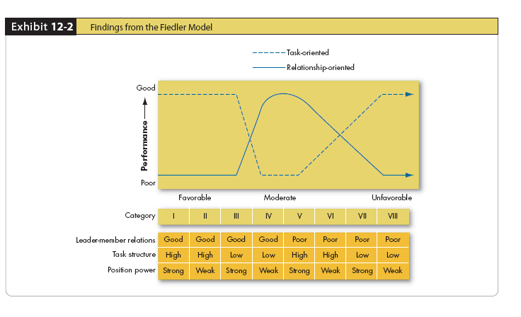
Findings from Fiedler Model
E X H I B I T 12–2
© 2007 Prentice Hall Inc. All rights reserved.

Slide 26
Contingency Approach: Hersey & Blanchard Situational Model
Considers Leader Behaviors (Task & Relationship)
  Assumes Leaders CAN change their behaviors
Considers Followers as the Situation
  Follower Task maturity (ability & experience)
  Follower Psychological maturity (willingness to take responsibility)
Assumptions
  Leaders can and should change their style to fit their followers’ degree of readiness (willingness and ability)
  Therefore, it is possible to TRAIN leaders to better fit their style to their followers.

Slide 27
Hersey and Blanchard’s Situational Leadership Theory
Situational Leadership Theory (SLT)
A contingency theory that focuses on followers’ readiness; the more “ready” the followers (the more willing and able) the less the need for leader support and supervision.
LOW Amount of Follower Readiness HIGH
Amount of Leader Support &
Supervision Required
HIGH
LOW
© 2007 Prentice Hall Inc. All rights reserved.

Slide 28
Leadership Styles and Follower Readiness
(Hersey and Blanchard)
Follower Readiness
Unwilling
Willing
Able
Supportive Participative
(participating)
Monitoring
(Delegating)
Leadership
Styles
High Task
and
Relationship
Orientations
(selling)
Unable
Directive
(Telling)
© 2007 Prentice Hall Inc. All rights reserved.

Slide 29

Path-Goal Theory (Robert House & Others)
Premise
Leader must help followers attaining goals and reduce roadblocks to success
Leaders must change behaviors to fit the situation (environmental contingencies & subordinate contingencies)
© 2007 Prentice Hall Inc. All rights reserved.

Slide 30
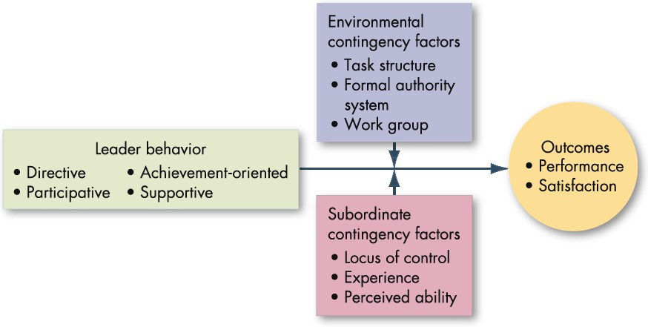
The Path-Goal Theory
Beliefs whether the employees achievements are product of his own efforts
E X H I B I T 12–4
© 2007 Prentice Hall Inc. All rights reserved.

